Slide 1




ONSCREEN
EYE-CONTROLLED
KEYBOARD FOR
PEOPLE WITH DISABLITIES
Team: GazeTech
Habiba Alaa
Nada Khaled
Mostafa Ali
Nouran Hany
Meram Mahmoud

Slide 2
TABLE OF CONTENTS
01
PROBLEM
STATEMENT
04
METHODOLOGY
02
MARKET
RESEARCH
05
BUDGET &
BUSINESS MODEL
03
LITERATURE
REVIEW
06
TIME
PLAN
07
TEAM
STRUCTURE

Slide 3

PROBLEM STATEMENT
Computers have rapidly evolved changing people’s lives, but their rapid advancement has created barriers for people with disabilities, particularly those with hand movement impairments.
01

Slide 4


PROBLEM STATEMENT
Computers have rapidly evolved changing people’s lives, but their rapid advancement has created barriers for people with disabilities, particularly those with hand movement impairments.

Slide 5

PROBLEM STATEMENT
The digital divide for people with hand movement disabilities highlights the necessity of assistive technologies. Our research aims to bridge this gap by developing tools that empower individuals with various disabilities to write text on computers.

Slide 6
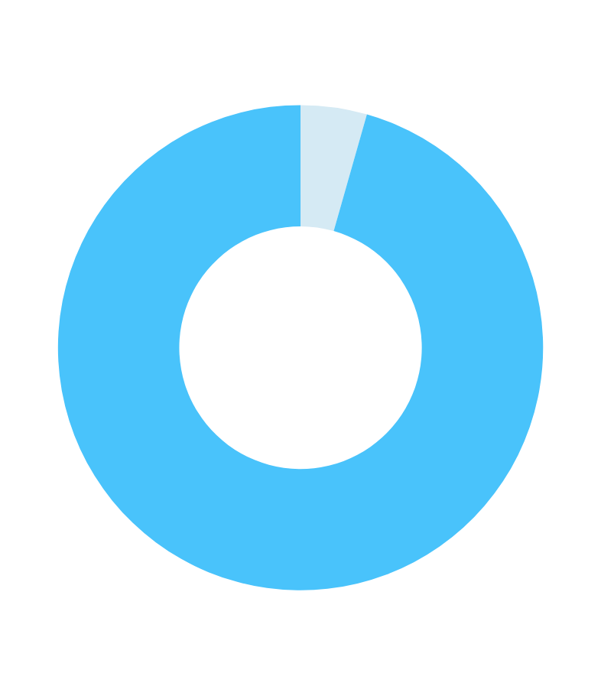
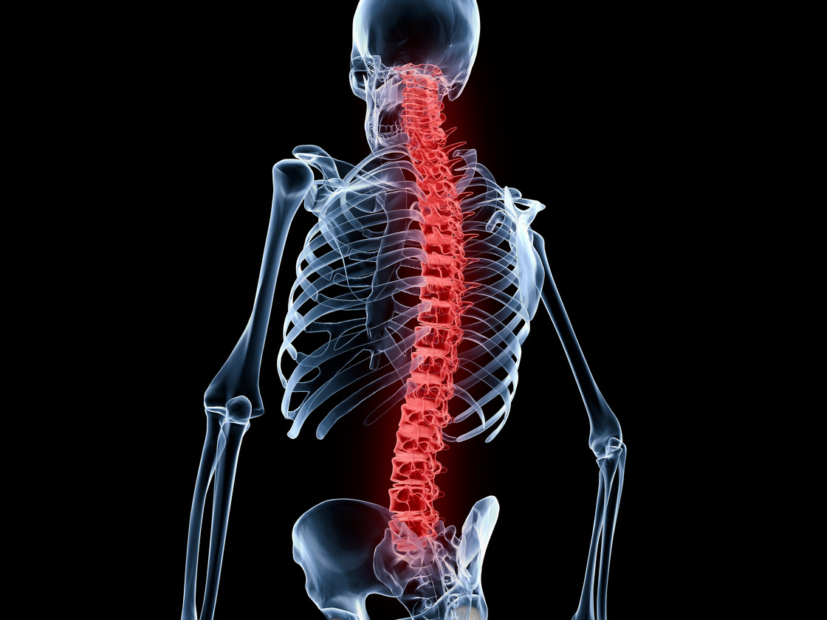
MARKET
RESEARCH
02
20.9 million SCI in 2019

Slide 7

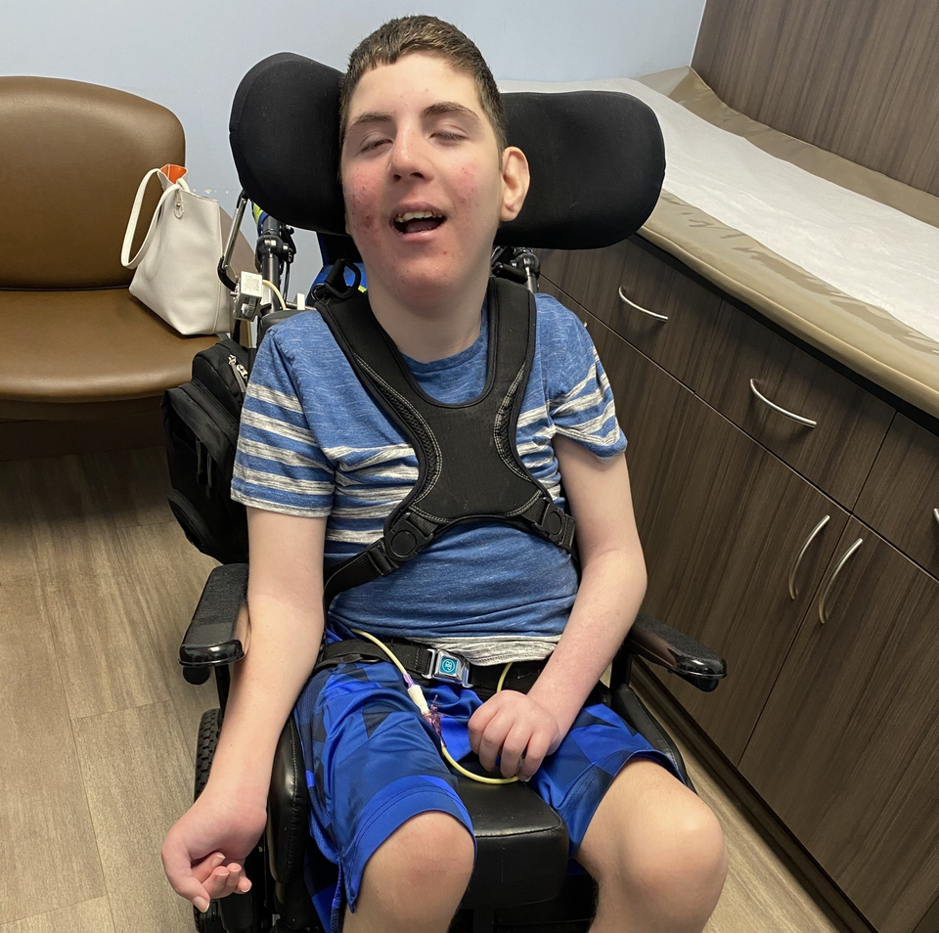
Hand impairment can be caused by
21.5 million SCI in 2019
Rehabilitative disabilities (e.g., spinal cord injuries)
Ding W, Hu S, Wang P, Kang H, Peng R, Dong Y, Li F. Spinal Cord Injury: The Global Incidence, Prevalence, and Disability From the Global Burden of Disease Study 2019. Spine (Phila Pa 1976). 2022 Nov 1;47(21):1532-1540. doi: 10.1097/BRS.0000000000004417. Epub 2022 Jun 30. PMID: 35857624; PMCID: PMC9554757.

Slide 8
Hand impairment can be caused by
20.9 million SCI in 2019
Motor disabilities (e.g. cerebral palsy).
McIntyre S, Goldsmith S, Webb A, Ehlinger V, Hollung SJ, McConnell K, Arnaud C, Smithers-Sheedy H, Oskoui M, Khandaker G, Himmelmann K; Global CP Prevalence Group*. Global prevalence of cerebral palsy: A systematic analysis. Dev Med Child Neurol. 2022 Dec;64(12):1494-1506. doi: 10.1111/dmcn.15346. Epub 2022 Aug 11. PMID: 35952356; PMCID: PMC9804547.

Slide 9


MARKET ANALYSIS
Market Size: The global market for eye-tracking keyboards is projected to grow significantly, with an estimated value of USD 1.8 billion by 2026, growing at a CAGR of 25.5% from 2021.
User Adoption: Approximately 1.5 million people worldwide use eye-tracking technology for communication and interaction, with a significant portion using it for keyboard input.

Slide 10
AVAILABLE OPTIONS
OptiKey
$229 *
Requires the use of an eye tracking device such as Tobii EyeX
EGP 11,000
Open Source
Arabic Letters
Difficulty in installation &
not widely available
English Letters
* Price of Tobii EyeX eye tracker.

Slide 11
LITERATURE REVIEW
03

Slide 12


SOLUTION
Tracking
Keyboard Mechanism

Slide 13

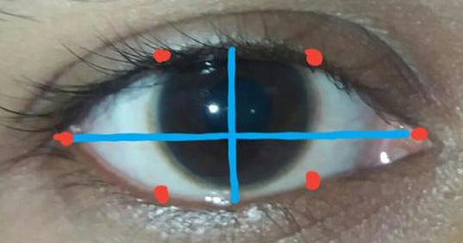
Tracking
Keyboard Mechanism

Slide 14

02
(EEG) based
01
Eye Gaze Controlled
Chakraborty, Partha & Roy, Dipa & Zahid, Zahidur & Rahman, Saifur. (2019). Eye Gaze Controlled Virtual Keyboard. International Journal of Recent Technology and Engineering. 8. 3264-3269. 10.35940/ijrte.D8049.118419.
Robiul Islam, Md & Rahman, Md & Sarkar, Anamica. (2021). Computer Vision Based Eye Gaze Controlled Virtual Keyboard for People with Quadriplegia. 1-6. 10.1109/ACMI53878.2021.9528213.

Slide 15
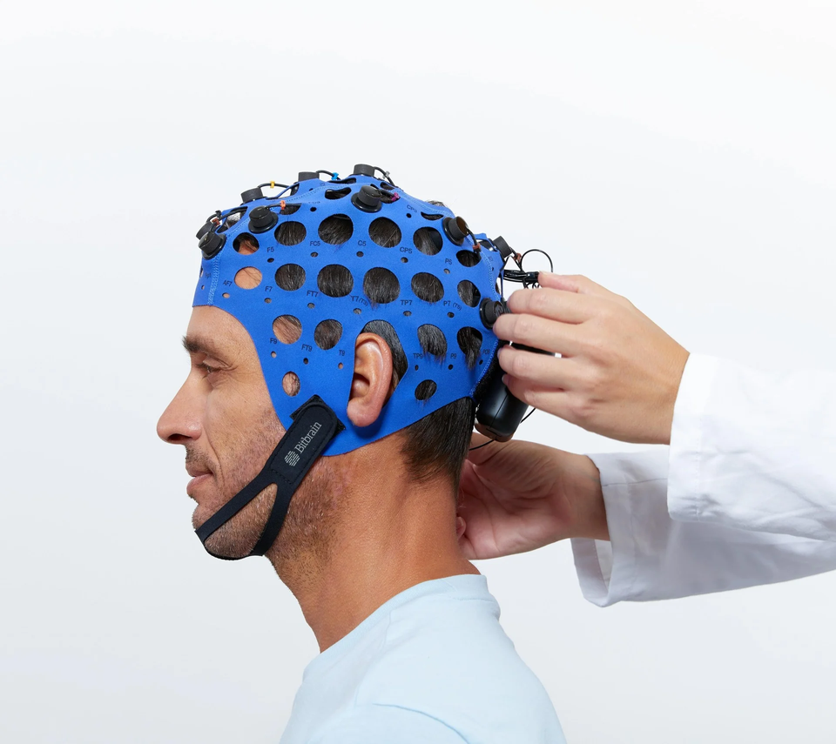
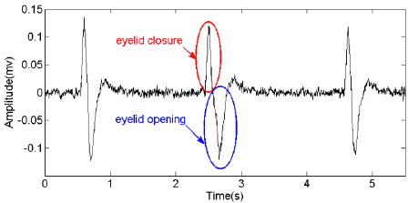
01
Eye Gaze Controlled
02
(EEG) based
Dobosz, Krzysztof & Stawski, Klaudiusz. (2018). Touchless Virtual Keyboard Controlled by Eye Blinking and EEG Signals. 52-61. 10.1007/978-3-319-67792-7_6.
Keyboard Mechanism

Slide 16
Keyboard Mechanism

Slide 17

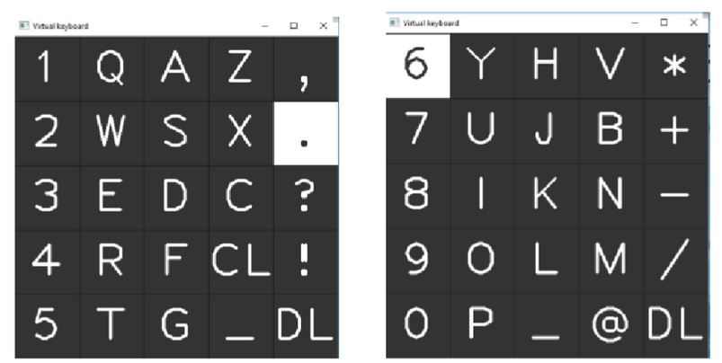
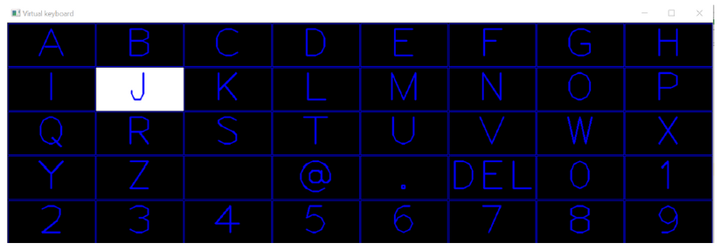
01
Eye Gaze Controlled Virtual Keyboard
Separating the keyboard into left and right sections. The letters light up sequentially and can be chosen by the user using blinking.
Chakraborty, Partha & Roy, Dipa & Zahid, Zahidur & Rahman, Saifur. (2019). Eye Gaze Controlled Virtual Keyboard. International Journal of Recent Technology and Engineering. 8. 3264-3269. 10.35940/ijrte.D8049.118419.
Robiul Islam, Md & Rahman, Md & Sarkar, Anamica. (2021). Computer Vision Based Eye Gaze Controlled Virtual Keyboard for People with Quadriplegia. 1-6. 10.1109/ACMI53878.2021.9528213.

Slide 18
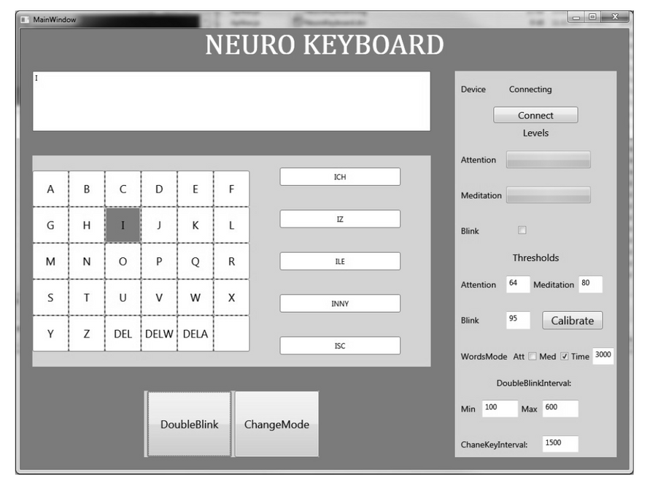
02
NeuroKeyboard
Using a divide and conquer approach to loop through the letters faster. Choosing a letter requires double blinking 3 times, which strains the user’s eyes. Also provides a predictive text mode which can be accessed using EEG signals.
Dobosz, Krzysztof & Stawski, Klaudiusz. (2018). Touchless Virtual Keyboard Controlled by Eye Blinking and EEG Signals. 52-61. 10.1007/978-3-319-67792-7_6.

Slide 19
METHODS
04

Slide 20

Common problem?
SPEED

Slide 21

iKey

Slide 22
iKey
Tracking
Keyboard Mechanism

Slide 23
Tracking

Slide 24
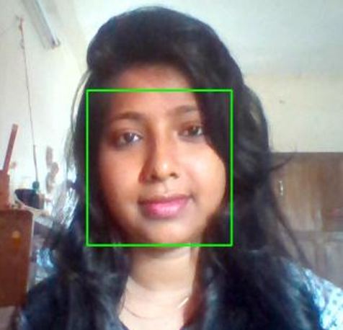
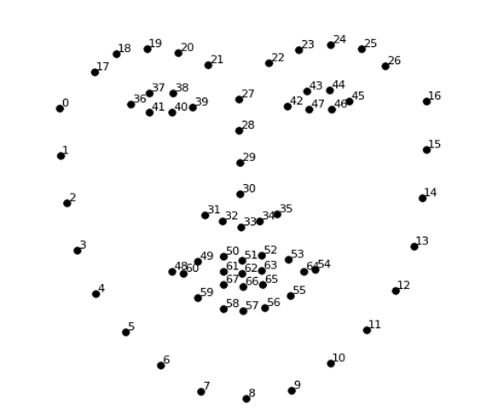
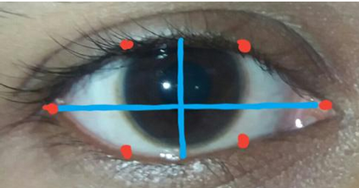
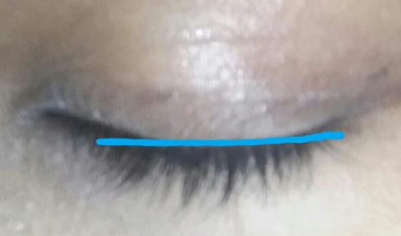
01
Eye Gaze Controlled Virtual Keyboard
Face detection
Eye detection
eye gaze detection
eye blinking detection
Chakraborty, Partha & Roy, Dipa & Zahid, Zahidur & Rahman, Saifur. (2019). Eye Gaze Controlled Virtual Keyboard. International Journal of Recent Technology and Engineering. 8. 3264-3269. 10.35940/ijrte.D8049.118419.

Slide 25
Keyboard Mechanism

Slide 26
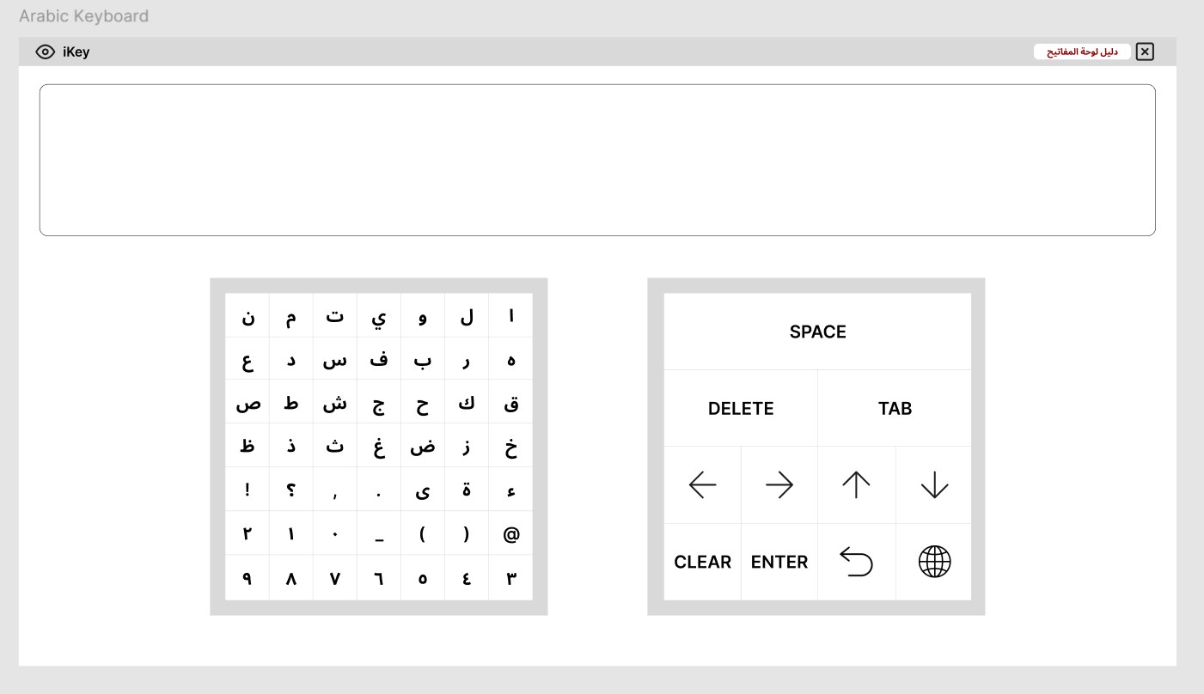
ARABIC MODE
Preliminary Design for iKey (Arabic)
iKey

Slide 27
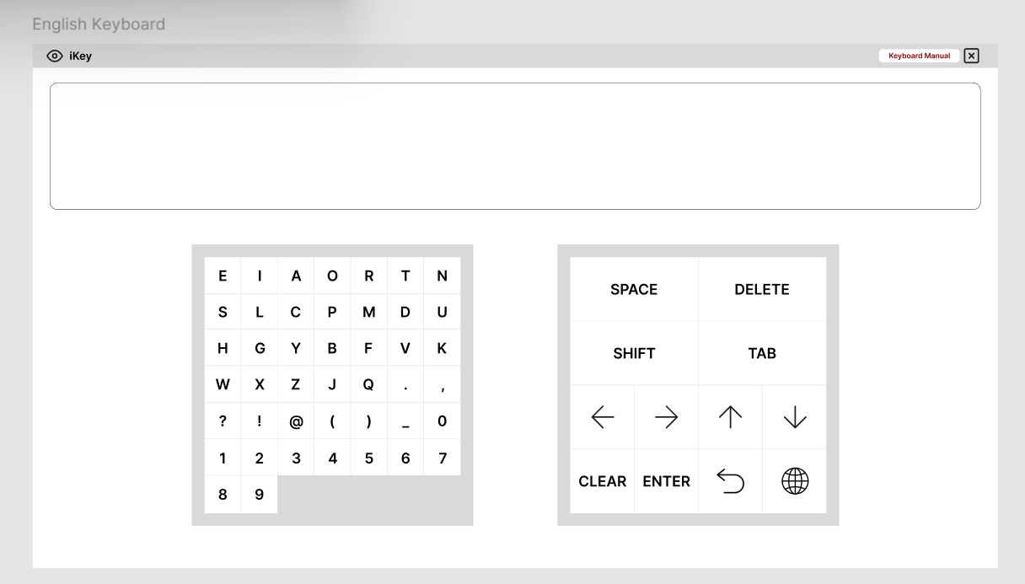
ENGLISH MODE
Preliminary Design for iKey (English)
iKey

Slide 28
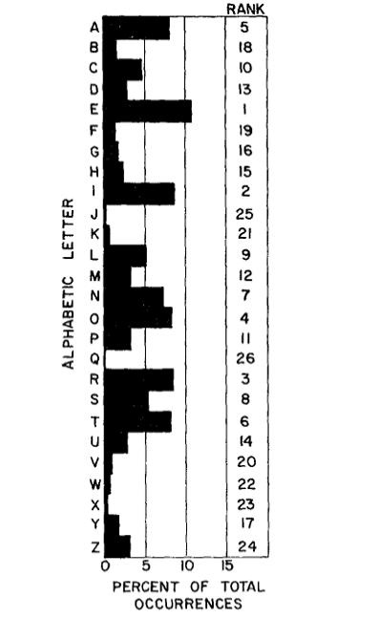
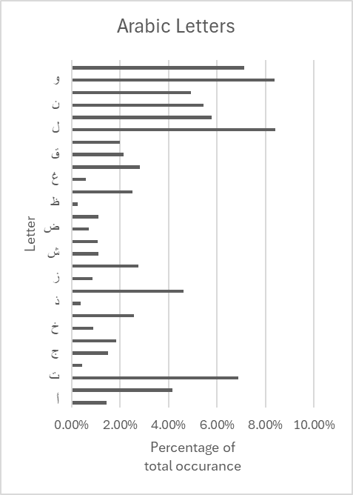
Frequency of letters in English words
Matrices of the frequency and similarity of Arabic letters and allographs
Charles P. Bourne, Donald F. Ford, A study of the statistics of letters in English words, Information and Control, Volume 4, Issue 1, 1961, Pages 48-67, ISSN 0019-9958, https://doi.org/10.1016/S0019-9958(61)80036-3.
Boudelaa, S., Perea, M. & Carreiras, M. Matrices of the frequency and similarity of Arabic letters and allographs. Behav Res 52, 1893–1905 (2020). https://doi.org/10.3758/s13428-020-01353-z
iKey

Slide 29

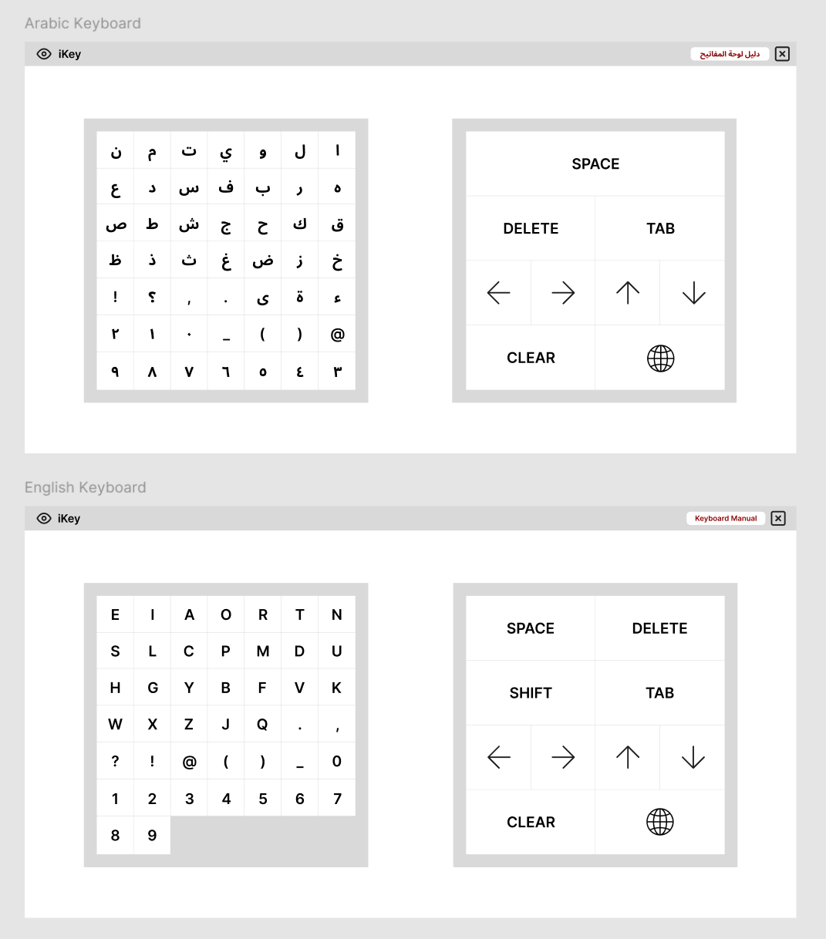

انا احب القراءة و الكتابة
iKey

Slide 30

S
W
O
T
SWOT
ANALYSIS

Slide 31
STRENGTHS
S

Slide 32





No Special Gear
Arabic Letters
EEG and eye-tracking devices are not needed
Easy Access
Text Prediction
More frequent letters are faster to access
Seamless Integration
Works in place of a physical keyboard
Less Eye Strain

Slide 33
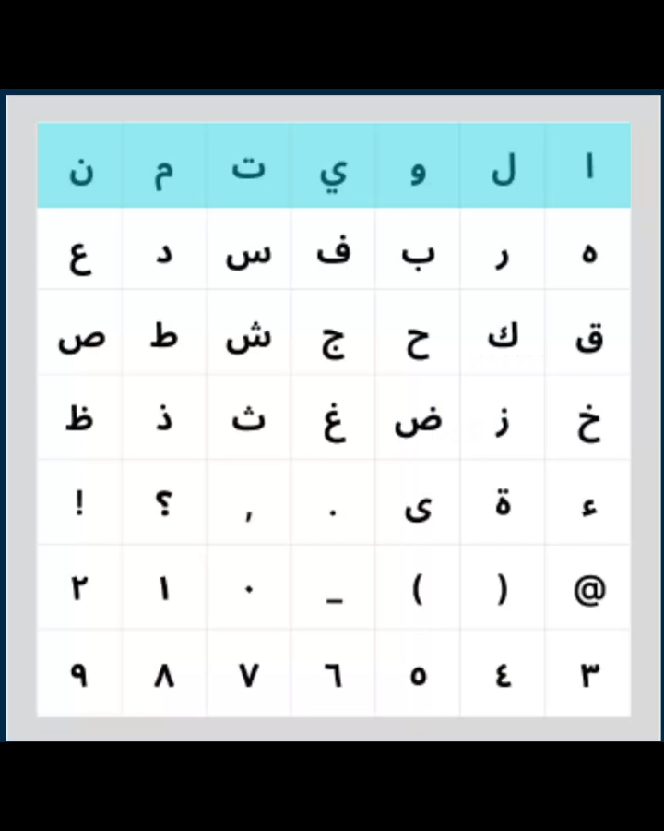

Easy Access
More frequent letters are faster to access

Slide 34
WEAKNESSES
W

Slide 35





Learning Curve
Missing Punctuation & Functionalities
The order of the letters is unfamiliar and requires practice.
No Backtracking
Taking up space
Users can’t go back to rows or letters they missed.
iKey takes up a portion of the screen and may block the view.
Semi-Independence
Switching between programs requires assistance

Slide 36
O
OPPORTUNITIES

Slide 37


Language customization potential
Development of a companion cursor app for full independence

Slide 38
T
THREATS

Slide 39


Apps with advances eye-tracking technology
Using BCI to type letters based on signal pattern recognition

Slide 40
BUDGET &
BUSINESS MODEL
05

Slide 41
TOTAL BUDGET
iKey

Slide 42






RESOURCES
Datasets & Volunteers
(MENA region)
AI models & CV algorithms
Equipped labs
Marketing platforms
Hosting servers
iKey
Notes:
Lab Space:
• Access to a computer lab equipped with the required hardware and software for development and testing.
• A controlled environment for conducting user trials with minimal distractions.
• Data Collection:
• Experiments to gather data on eye movement and blinking patterns from volunteers.
• Controlled trials to test the accuracy and usability of the virtual keyboard.
• User Testing:
• Recruit participants, including individuals with various disabilities, to test the keyboard.
• Collect feedback on the interface, usability, and comfort during extended use.
Collaborations:
• Partnerships with healthcare and accessibility organizations for promoting and validating the product.

Slide 43

One-time sales, partnerships.
Partners
Development, operations, marketing.
Revenue Streams
Healthcare organizations, AI & CV experts.
Cost Structure
Customer Relationship
Activities
Business Model
Feedback mechanism, Support Services.
Develop AI models, integrate software with laptops, improve through user feedback.
Channels
Website, healthcare providers.
Resources
Customer Segments
GPUs, hosting servers, marketing platforms, and volunteers
Value
People with disabilities, healthcare professionals.
Accessibility, Bilingual Support,
Ease of Use.

Slide 44
06
TIME PLAN

Slide 45



TIME PLAN
Prototype & Software Development
Project Planning
Launch & Outreach
8-10 weeks
6-8 weeks
2-3 weeks
10-12 weeks
4-6 weeks
Data Prep & Algorithm Development
UI/UX & System Integration
Ongoing Support & Maintenance
iKey

Slide 46

Thank You

